Slide 1
Security of Information Systems
Challenges and opportunities
SAI India

Slide 2
Digital Ecosystem in India
Transformation enablers
Information Technology Act 2000
National eGovernance Plan 2006
34 Mission Mode projects
Enabling network infrastructure (SWANs)
Common Service Centres
NeGP 2.0 - 2014
Mobile first
UPI –mobile interbank payment interface
Web enabling governance
Ongoing Implementation of high speed Fibre optics network connecting 625000 villages
Compliance to security measures
UPI -an AI based cyber risk management platform (TAC Security)
494 million people online in 2018
360 million smartphone users –
among 1.2 bn mobile connections
1.23 billion Unique Biometric IDs
330 million bank accounts for poor
25 billion e-payment transactions in 2018
USD 40 billion –Direct Benefit transfer
Secure and stable digital infrastructure
Govt Cloud infrastructure
Transform e-Governance
Digital literacy for all

Slide 3
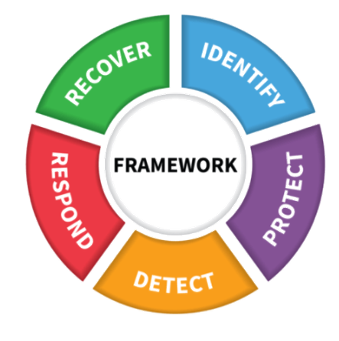
Legal framework for IT Security in India
Executive orders
IT Rules on security procedures 2004
eGov Security assurance Framework 2010
Third party security audits of public IT applications 2011
National Cyber security policy 2013
National Information Security Manual 2014
Protection of critical information infrastructure 2014
Roles of CISOs 2017
Cyber crisis Management Plan 2018
Personal Data Protection Bill 2018
Data privacy concerns with Unique ID usage
Standard setting bodies
NCIIPC
CERT-IN
STQC
IT Act 2000 –
Recognises electronic records and digital signatures
PKI and electronic payments
Cybercrime and e-commerce
Amendments made to address emerging cyber security concerns
Cybersecurity Framework

Slide 4
SAI India – Audit of Information systems
Audit of Systems under development
Audit of implementations
Standalone systems in a pre-web enabled era
Use of CAATs and substantive tests
Review of Application controls
Review of General Controls
Security of standalone systems - Access controls; Business continuity plan etc.
IT Audit Manual and toolkit 2006
Guidance documents on audit of similar nature of applications
Capacity Development
Focused on use of CAATS, Database query tools
Software Development Life Cycle; IT Controls; IT Security (policies, procedures etc.)

Slide 5
Auditing Information security
Audit Case Study – e procurement -

Slide 6
E-Procurement
IT-enabling Public Procurement
> 20% of Government spending (~600 bn USD)
Decentralised, opaque, limited competition
Move public procurement to web-based digital platforms
Variety of models in Indian states
Similar goals
Web-based e-commerce platforms
Multiple departments (buyers) and sellers
Use of Digital signature certificates and Public Key infrastructure
Enabled by IT Act 2000

Slide 7
Evaluation of security controls – typical findings
Audits in different state jurisdictions
Early reports 2006-13
Operational and Management controls
Escrow agreement
Information Security policies
Business Continuity Plans
Quality of back up data.
Violation of Segregation of Duties
Use of Departmental admin User IDs by vendor personnel
Third party security audits not done
PKI implementation not adequate
Activities permitted without verifying DSCs
E-Gov Security Assurance Framework

Slide 8
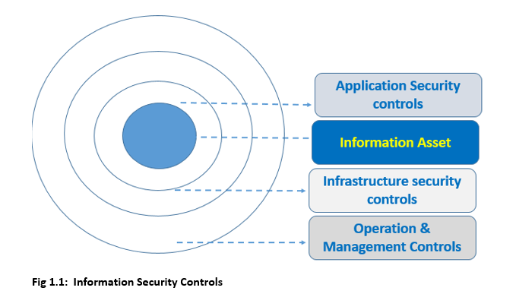
Evaluation of security controls - findings
Recent reports: 2014-18
Covers multiple layers of security controls
Infrastructure controls in terms of PKI deficiencies
Multiple DSCs mapped to single vendors –submitting multiple bids
Multiple bids in many tenders from same IP location
Greater focus on core application level vulnerabilities
On coverage of vulnerabilities by 3rd party security audits

Slide 9
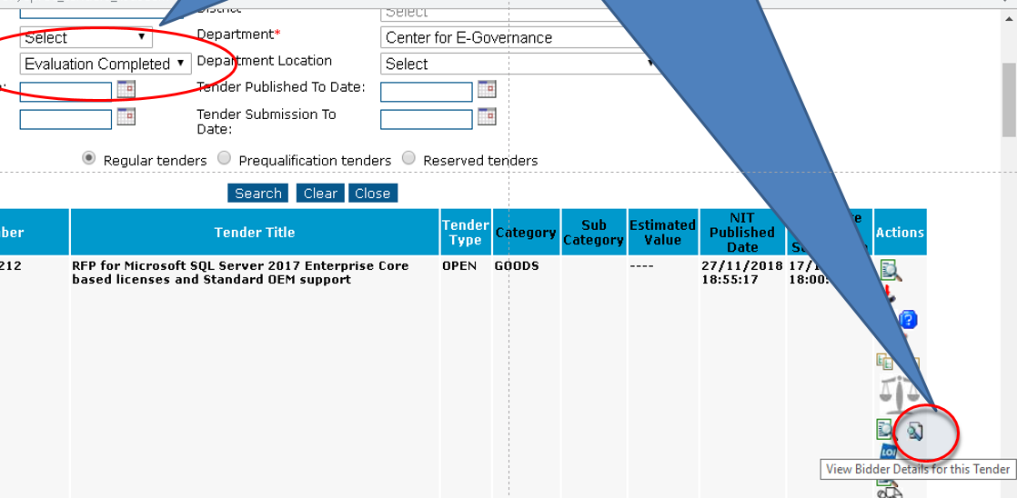
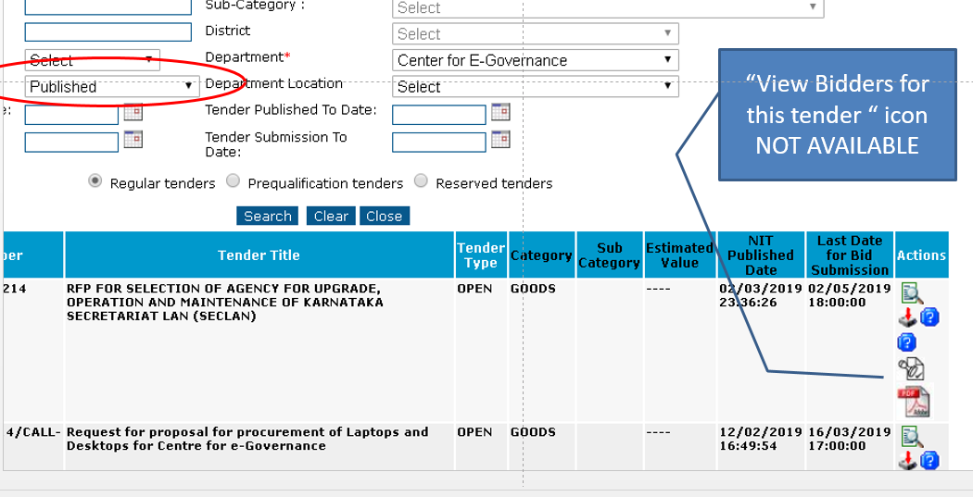
Evaluation of security controls
Identifying existent application vulnerabilities –
Prima facie access restriction for open bids
Testing with Scripted URLs

Slide 10
Challenges & Opportunities in auditing IS Security – SAI India
Manual on Audit of Information Systems needs to be updated
GUIDs 5100 and 5101
Auditing in the context of new technologies
Capacity building of staff for IS audit
MoUs with expert agencies for understanding of vulnerabilities (e.g. cloud environment)
Exchange Knowledge through WGITA
Mainstreaming of IS Audit skills still a work-in-progress
Into regular (performance/ compliance/ financial audits)
For staff engaged in Quality Assurance of Audit Reports

